Slide 1
Applied Physics NS (101)
LECTURE # 2
DATE: 20TH AUGUST , 2019

Slide 2


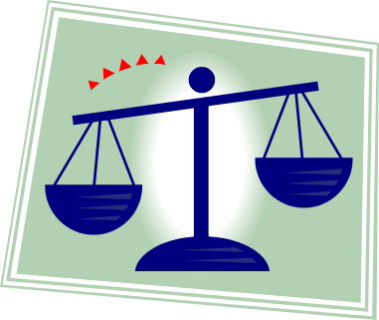
Scalars
A scalar quantity is a quantity that has magnitude only and has no direction in space
Examples of Scalar Quantities:
Length
Area
Volume
Time
Mass

Slide 3
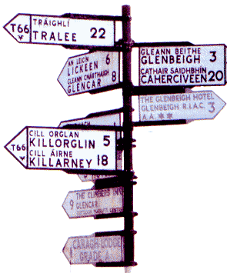
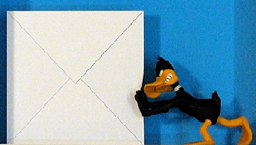
Vectors
A vector quantity is a quantity that has both magnitude and a direction in space
Examples of Vector Quantities:
Displacement
Velocity
Acceleration
Force

Slide 4
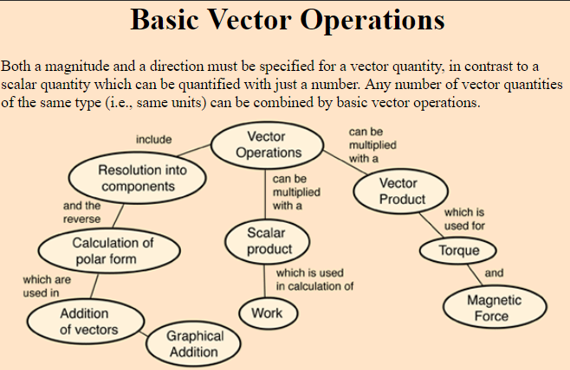

Slide 5
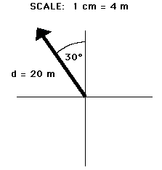
Vector Diagrams
Vector diagrams are shown using an arrow
The length of the arrow represents its magnitude
The direction of the arrow shows its direction

Slide 6


Types of Vector

Slide 7

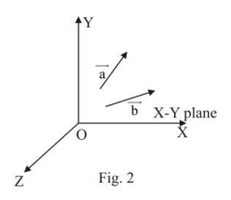

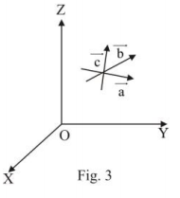


Slide 8




Slide 9
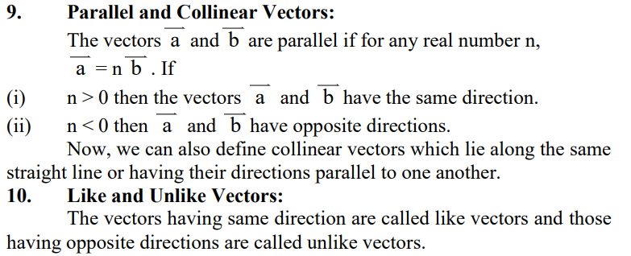


Slide 10
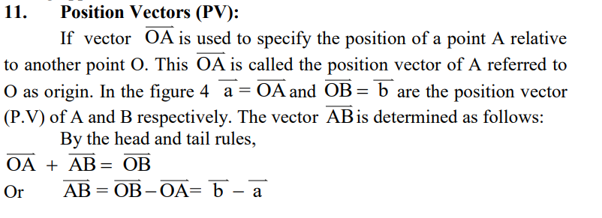
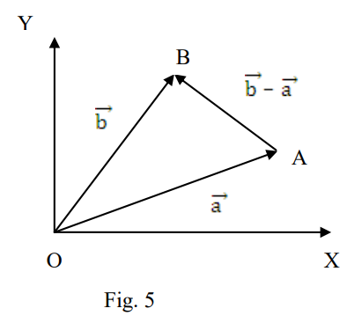

Slide 11
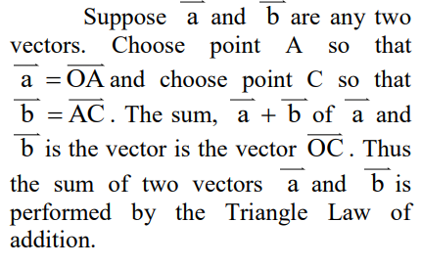
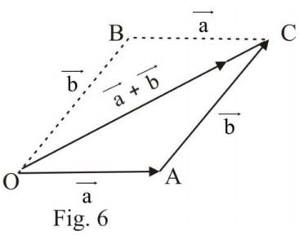
Addition of Vectors

Slide 12

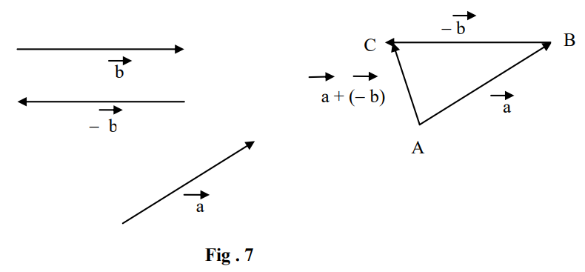
Subtraction of Vectors

Slide 13

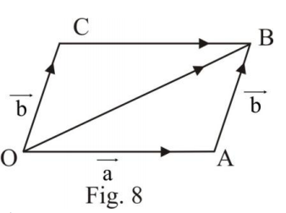

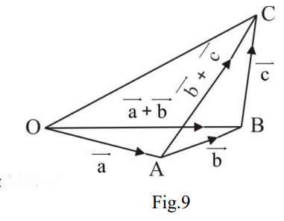
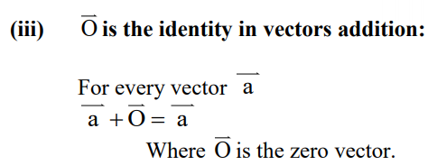
Properties of Vector Addition

Slide 14



Multiplication of a Vector by a Scalar

Slide 15
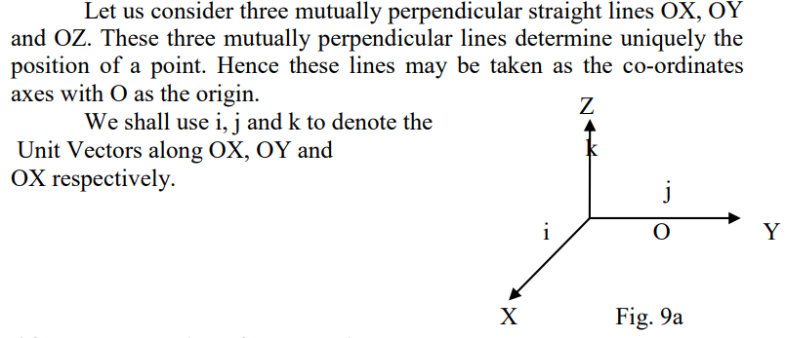




The Unit Vectors i, j, k
(orthogonal system of unit Vectors)

Slide 16


Product of Vectors

Slide 17



Product of Vectors

Slide 18
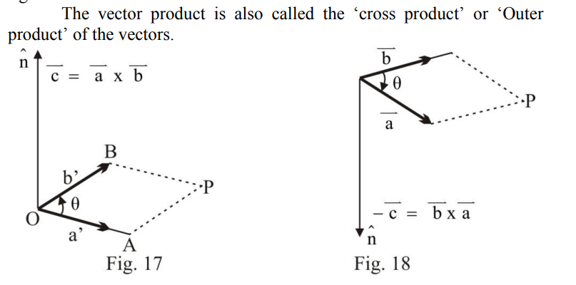


Slide 19
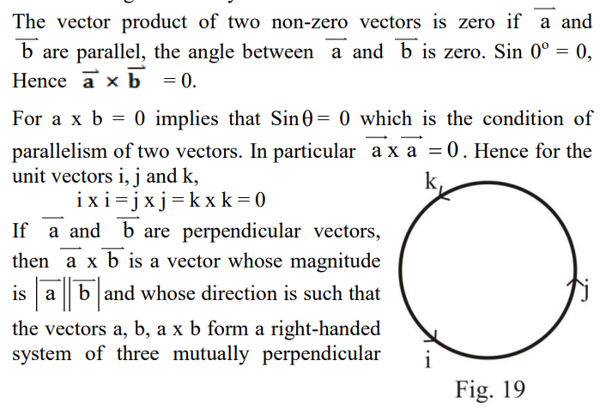


Slide 20

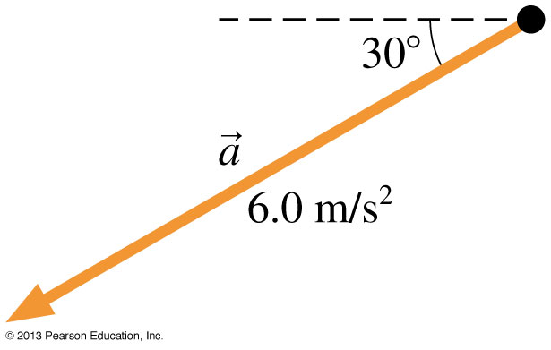
Example: Finding the Components of an Acceleration Vector
Find the x- and y-components of the acceleration vector a shown below.

Slide 21
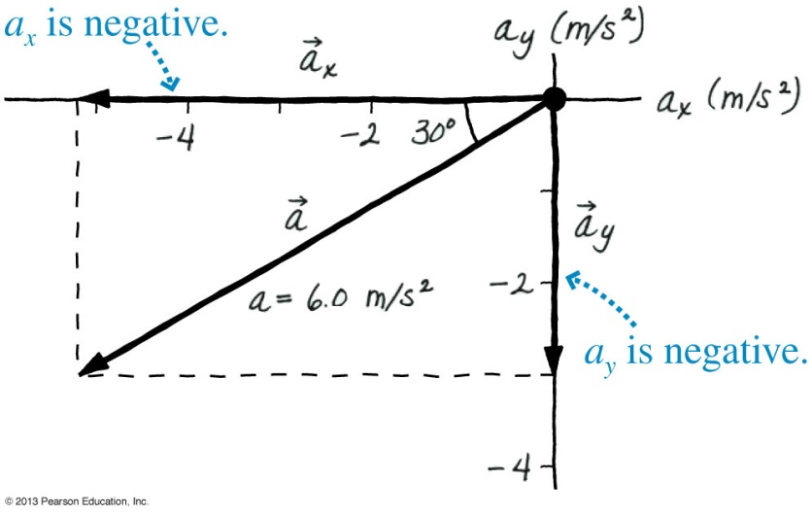
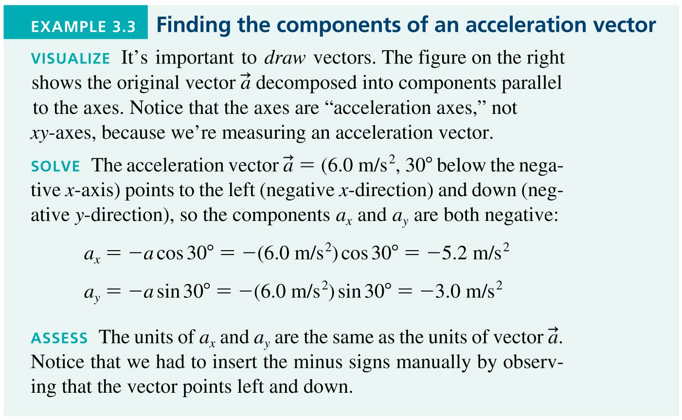
Example: Finding the Components of an Acceleration Vector

Slide 22

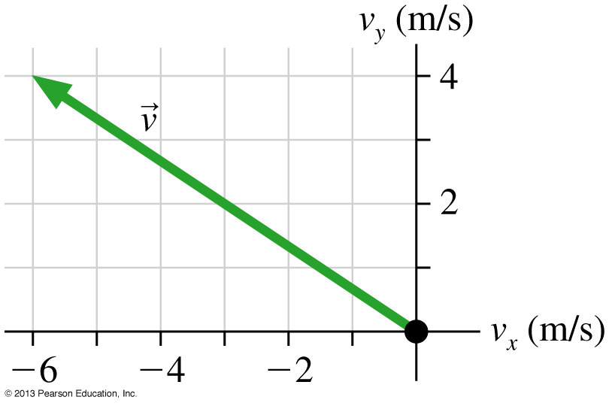
Example Finding the Direction of Motion

Slide 23
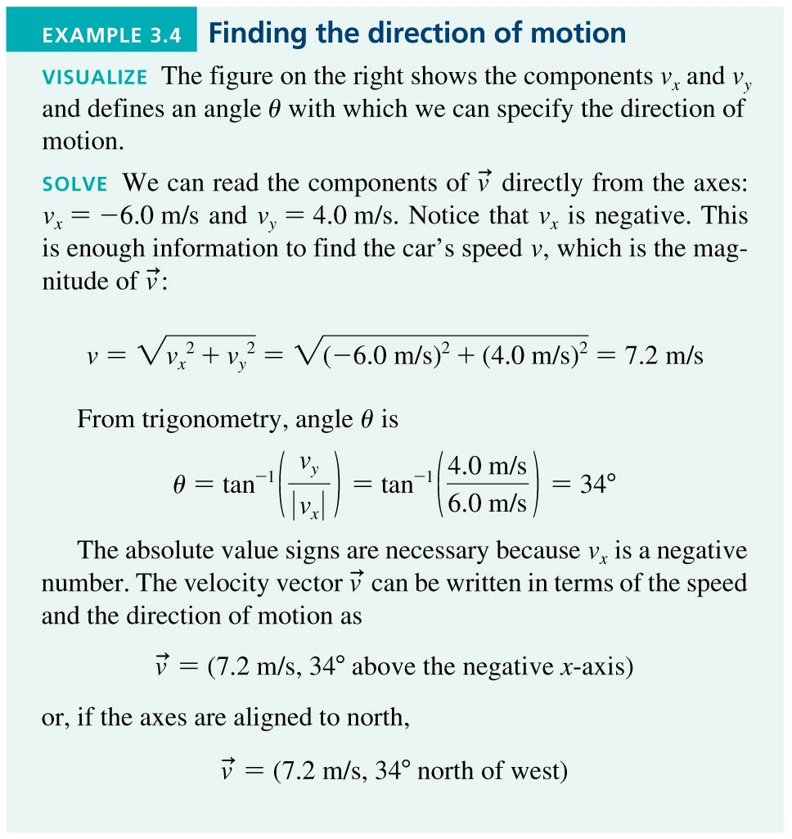
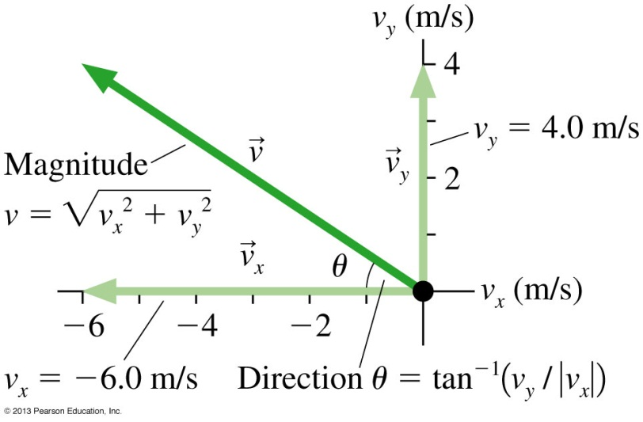
Example Finding the Direction of Motion

Slide 24

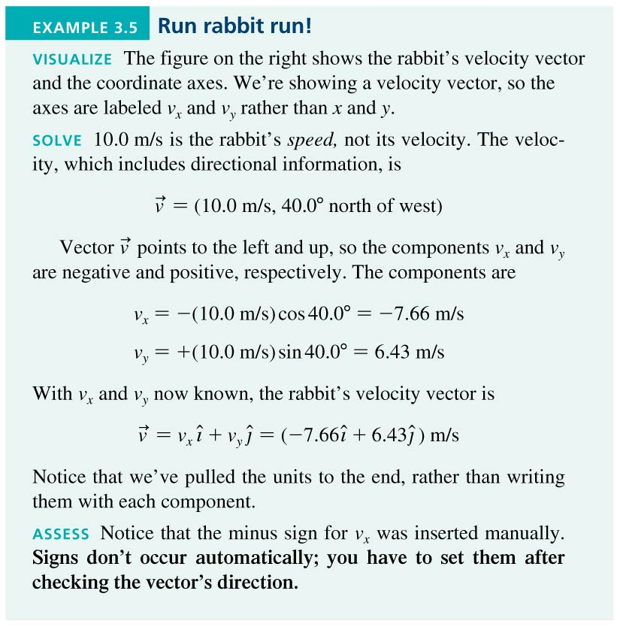
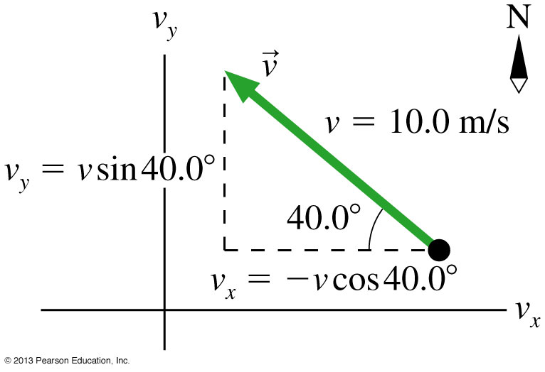
Example 3.5 Run Rabbit Run!

Slide 25







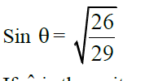


Slide 26

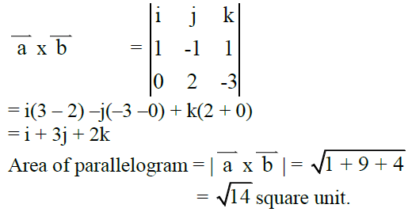

Slide 27

